Slide 1
Dopa A Generalized Android App for Memory Enhancement
Submitted by - linganesan

Slide 2
Outline
Problem Conceptualization
Introduction to the system
Project Objectives
System Implementation
Conclusion

Slide 3
Basic Research: Problem Conceptualization
In Sri Lanka, the widely used mechanism for associating is the ‘Repetition’.
Is it a efficient one?
We just need to replace our existing inefficient associating way with something spectacular and stunning, with something already proved and practiced.
Visualization is one such association mechanism.
A new way of mechanism to remember things
Mnemonic Devices

Slide 4

What is a Mind Palace?

Slide 5
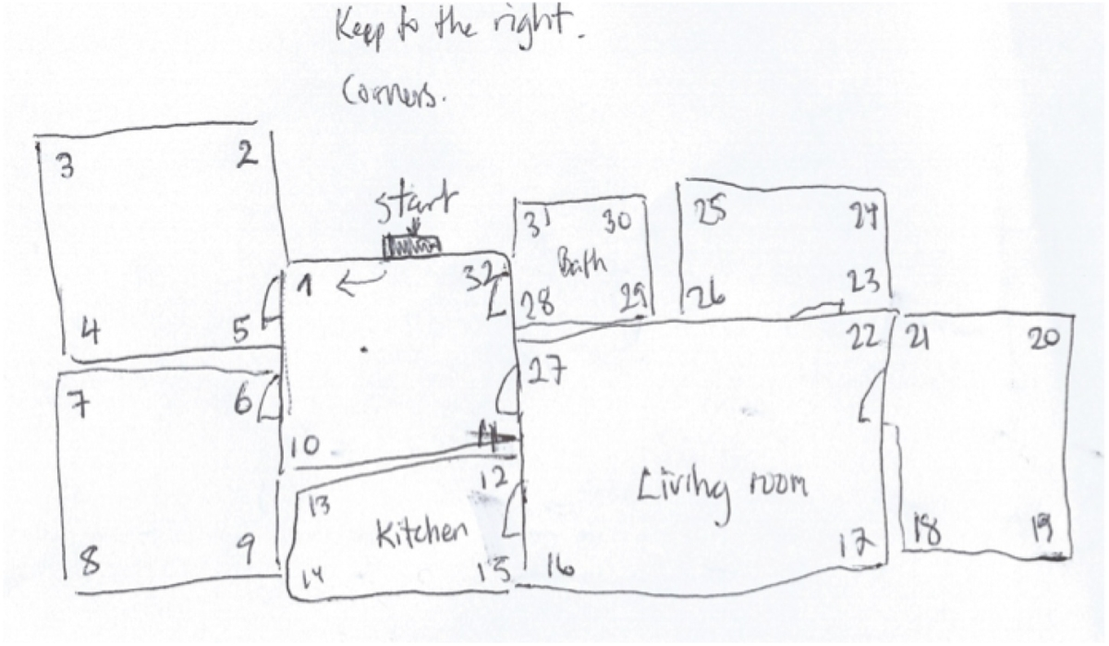
How to build a Mind Palace?
Choose Your Palace
Define a route.
Imprint the Palace on Your Mind
Remember to practice!

Slide 6
Project Objectives
Introduce/remind the power of visual based memory
Introduce/remind and ingrain Mind palace strategy
Focused on finding the ways to adopt visual learning among Autodidacts to assess learning progress, predict performances, use memory techniques and rack potential issues. In order to achieve self-motivated and self-taught students in the future.

Slide 7
Why Dopa?
Users can practice with their mind palace and able view their improvements through a specific profiling
Focused on Autodidacts
Core Requirements
Users should be able to create a mind palace in the system
Users should be able to practice with their mind palace
Users should test their memory power through a practice session
Specific profiles about users progress will be kept

Slide 8
System Implementation
An Android mobile application
Highly considering the usability
Intelligent feedbacks system and profiling
Built in database system
The project dopa is consisted of four well-separated modules.
Theory pages
Training Area
MindPalace
Intelligent Feedbacks and Profiling

Slide 9
CHECK LIST
Build a mind palace in database
Practice the route
Play memory challenges
Use mind palace in day to day life

Slide 10
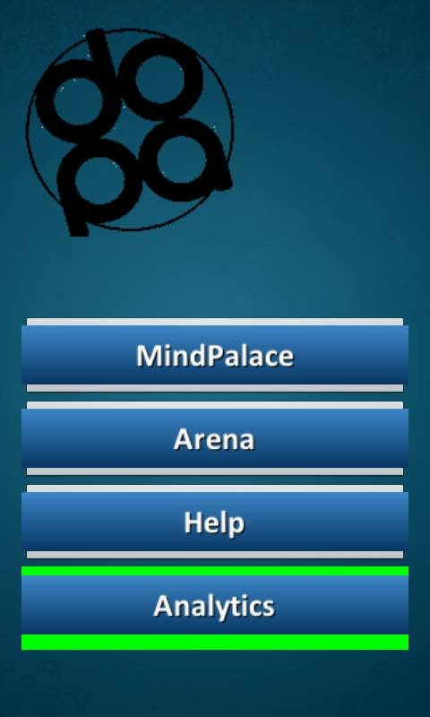
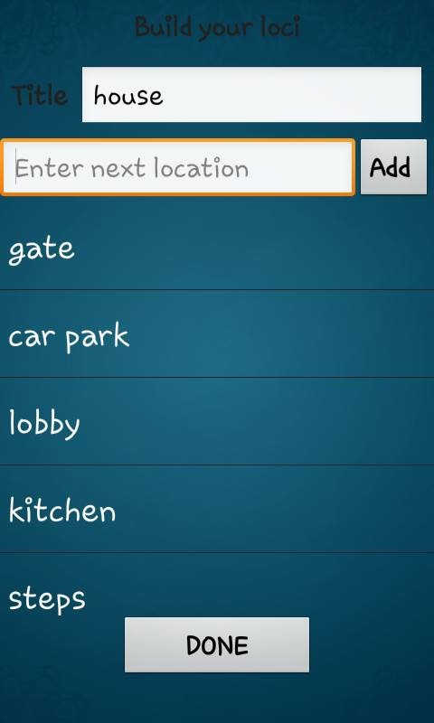
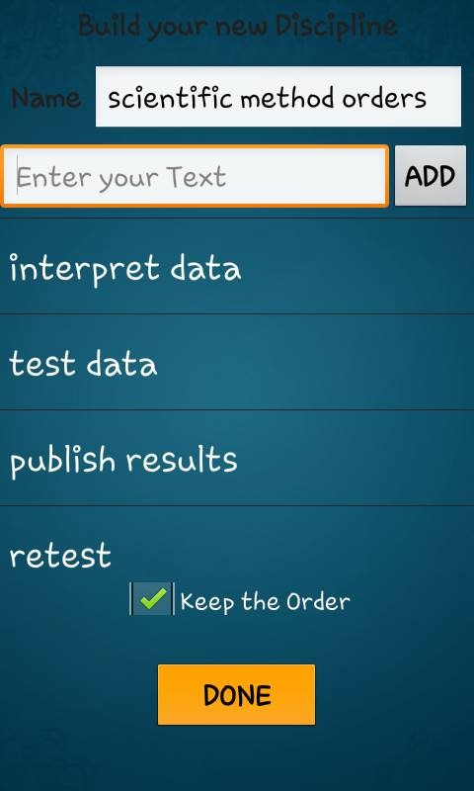
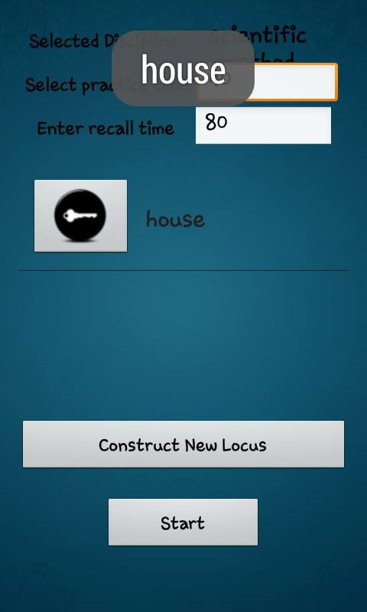

Slide 11
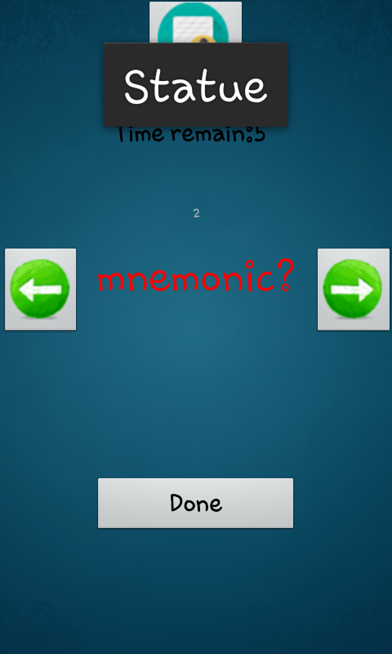
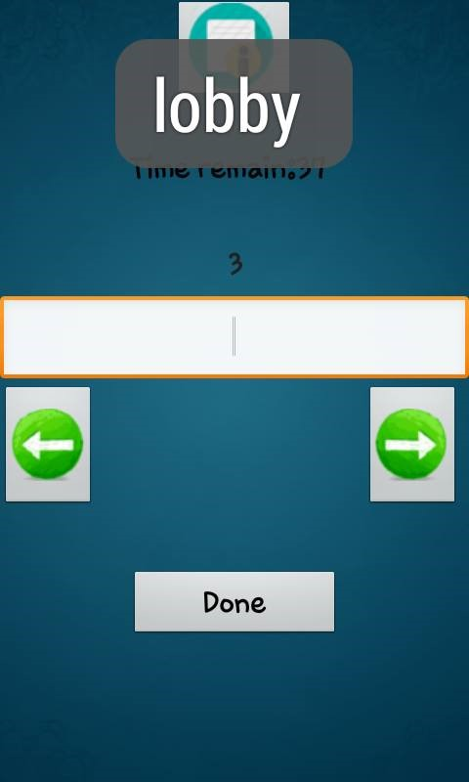
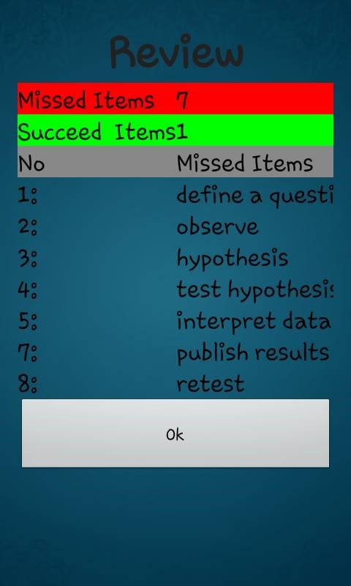

Slide 12
Conclusion
Introduce/remind the users the visual based learning methodologies.
The vision is to help as many people to become autodidacts
Followings are the future plans and expected features
More interactive and attractive UI, better UX In built disciplines, such as Cards
Practicing Mind palace route
Challenges and comparisons
Generalize input types (images/photos, sound etc.)

Slide 13
Thank you
Q & A

